Slide 1

Predicting Stroke Risk Using Machine Learning Models
Data Preprocessing, Analysis, and Model Evaluation

Slide 2
Contents
Introduction & Objectives
Dataset Overview
Data Exploratory
Data Visualization
Data Encoding
Model Training and Evaluation
Observation

Slide 3

Objective of the project:
Stroke is a major global health issue, causing significant morbidity and mortality worldwide. This project aims to develop a predictive model to assess stroke risk by analyzing healthcare data, including demographics, lifestyle, and medical history. Through data exploration and machine learning, it seeks to uncover key risk factors and enable proactive healthcare management

Slide 4

Goal & Expected Results
Analyze the dataset, which includes demographic, lifestyle, and medical history attributes, to uncover key factors contributing to strokes.
Perform data exploration and preprocessing to ensure data quality and relevance.
Leverage machine learning techniques to build a reliable and accurate predictive model for stroke risk assessment
A well-performing predictive model with high accuracy in identifying stroke risk.
Insights into significant factors influencing stroke occurrences.
A tool to support proactive healthcare decision-making and improve stroke prevention strategies

Slide 5
Project Overview
Data Exploration
Data Visualization
PROJECT OVERVIEW
Data Encoding
Machine Learning Models
This project aims to predict stroke risk using a healthcare dataset. It involves data preparation, visualization to uncover patterns, encoding categorical variables, and applying machine learning models to develop an accurate and reliable predictive system for proactive healthcare management

Slide 6
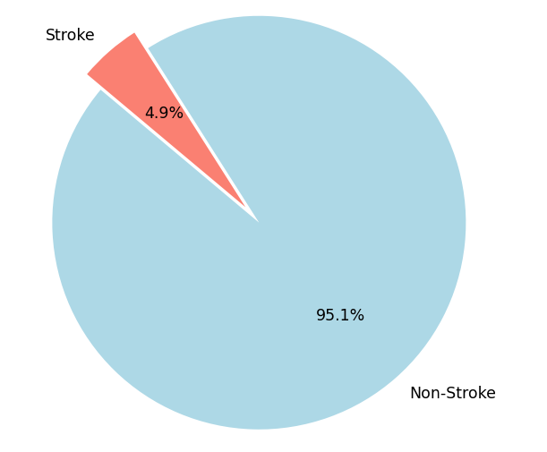
Dataset Overview
Size
Key Features:
Target
5,110 records and 12 features
gender,age,hypertension,heart_disease,ever_married,work_type,Residence_type,avg_glucose_level,bmi,smoking_status
stroke (1 = stroke, 0 = no stroke).

Slide 7
Data Exploration
Basic Dataset Information
The dataset contains 5110 rows and 12 columns.
Unique Values in 'gender' Column
The 'gender' column contains the following unique values: ['Male', 'Female', 'Other'].
Unique Values in 'smoking_status' Column
The 'smoking_status' column contains the following unique values: ['formerly smoked', 'never smoked', 'smokes’, 'Unknown’].
Missing Data
The dataset contains missing data in the following columns (with percentages): 'bmi': 3.93%.
Handling Missing 'bmi' Values
After dropping rows with missing 'bmi' values, the dataset contains 4909 rows.
Alternatively, after imputing the missing 'bmi' values with the mean value of 28.89, the 'bmi’ column no longer has missing values.

Slide 8
Data Exploration
Duplicate Rows
There are no duplicate rows in the dataset.
Stroke Rate by Gender (Proportion within Gender)
Female: 4.71% stroke rate.
Male: 5.11% stroke rate.
Other: 0% stroke rate.
Stroke Percentage by Gender (Relative to All Stroke Cases):
Female: 56.63% of total stroke cases
Male: 43.37% of total stroke cases

Slide 9
Overview:
The bmi column contained 201 missing values, accounting for 3.93% of the dataset.
Missing data can negatively impact model performance if not handled appropriately.
Handling Missing Data: Median Imputation
Methodology
Used median imputation to fill missing values, ensuring minimal impact from outliers in the data.
Impact:
All missing values in the bmi column were replaced with the median value
Ensured that the dataset remains complete for analysis and machine learning

Slide 10

Data Visualization

Slide 11
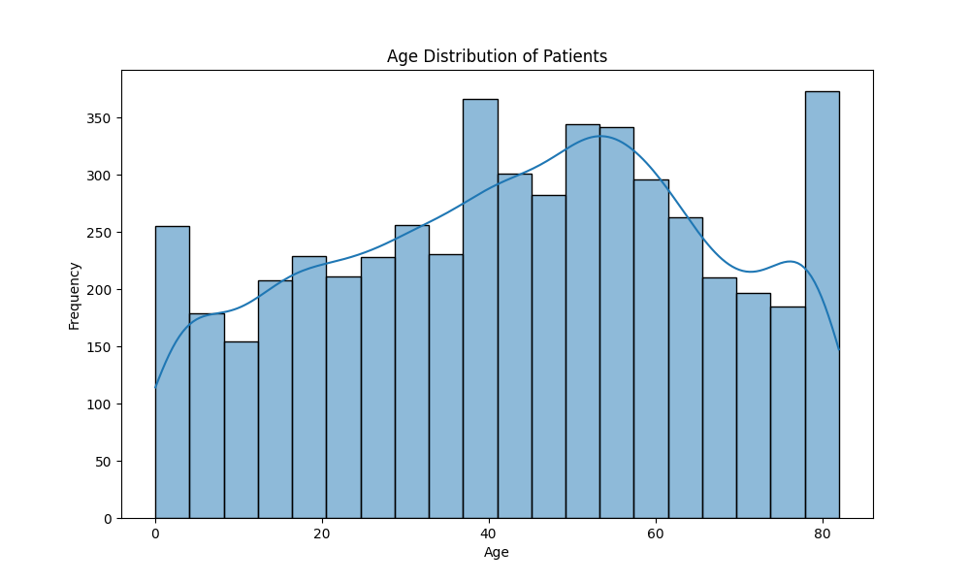
Data Visualisation
What is the age distribution among patients ?
The age distribution shows a roughly bimodal trend, with peaks around the ages of 40–60
and 80. There is a steady increase in patient numbers from younger ages up to middle age,
after which it drops slightly before peaking again in older age groups.

Slide 12
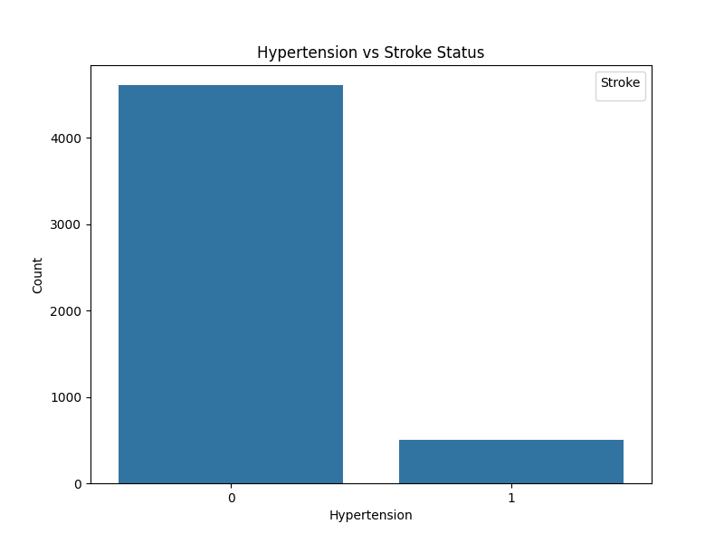
Data Visualisation
Is there a relationship between hypertension and the likelihood of having a stroke?
Most patients with hypertension do not have a stroke, as indicated by the large bar at the
zero mark. This suggests that while hypertension is a known risk factor, the majority of
hypertensive patients in this dataset have not experienced a stroke.

Slide 13
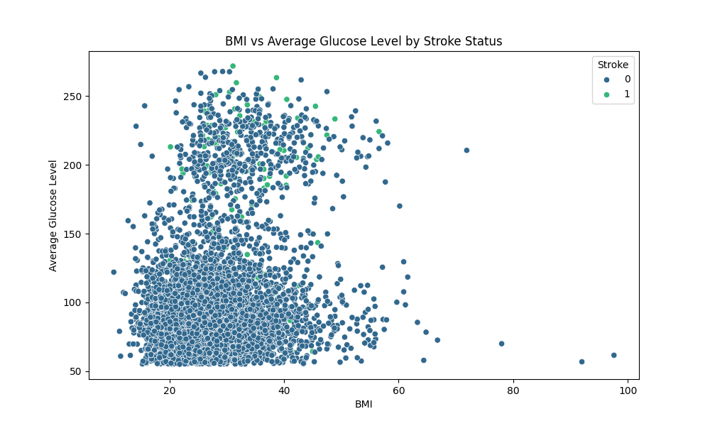
Data Visualisation
Is there any correlation between BMI and average glucose level among stroke patients?
Patients with higher glucose levels and a wide range of BMIs (especially in the 20-60 range) are present among both stroke and non-stroke groups.
Stroke cases (marked by a different color) tend to cluster more towards higher glucose levels, suggesting a possible link between elevated glucose levels and stroke occurrence

Slide 14
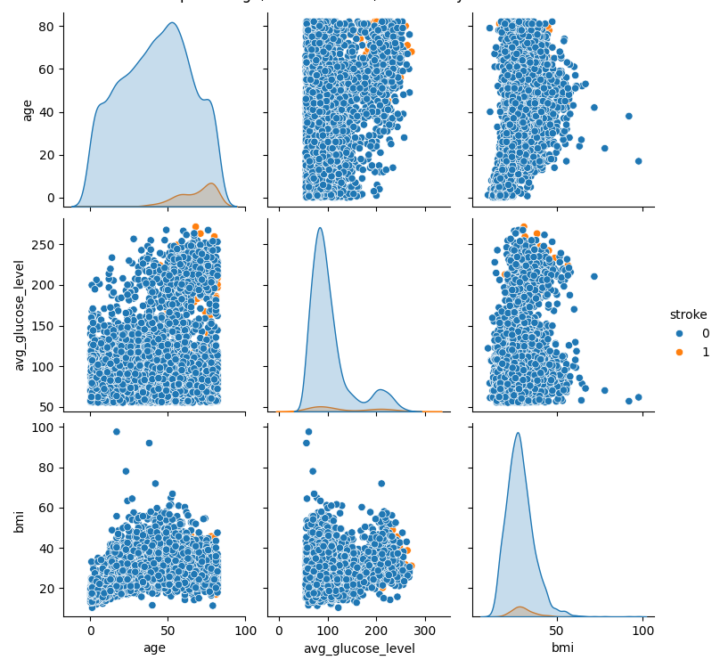
Data Visualisation
How do age, average glucose level, and BMI interact in relation to stroke status?
Patients who have experienced a stroke (indicated by orange markers) appear to cluster around
higher glucose levels and a wide range of ages, mostly over 40. There are a few outliers, with
higher BMI values but no clear pattern between BMI and stroke status. This suggests that age
and glucose level may have a stronger correlation with stroke than BMI alone.

Slide 15

Data Encoding

Slide 16
Why?
Encoding categorical variables into numerical formats is essential for machine learning algorithms, as they work best with numerical data. This process ensures compatibility, avoids misinterpretation of categories as ordinal, and eliminates redundancy or multicollinearity.
Impact:
This transformed dataset is entirely numeric, enabling efficient model training and better performance. The encoding ensures that no category is implicitly prioritized and maintains the interpretability of the features.

Slide 17
What?
Binary Encoding:
Encoded 'Residence_type' as 1 (Urban) and 0 (Rural) for simplicity.
Converted 'ever_married' to binary: 1 for 'Yes' and 0 for 'No’.
One-Hot Encoding:
Transformed 'gender,' 'work_type,' and 'smoking_status' into multiple binary columns for each unique category.
Examples: 'gender_Male,' 'work_type_Private,' and 'smoking_status_never_smoked'.
How?
Work Type Encoding: Mapped each category (e.g., 'Private,' 'Self-employed') into individual binary columns.
Gender Encoding: Created separate binary columns for 'Male' and 'Female'.
Smoking Status Encoding: Added binary columns for 'formerly smoked,' 'never smoked,' 'smokes,' and 'Unknown.'
Created a new dataset by dropping the original categorical columns

Slide 18

Model Training and Evaluation

Slide 19
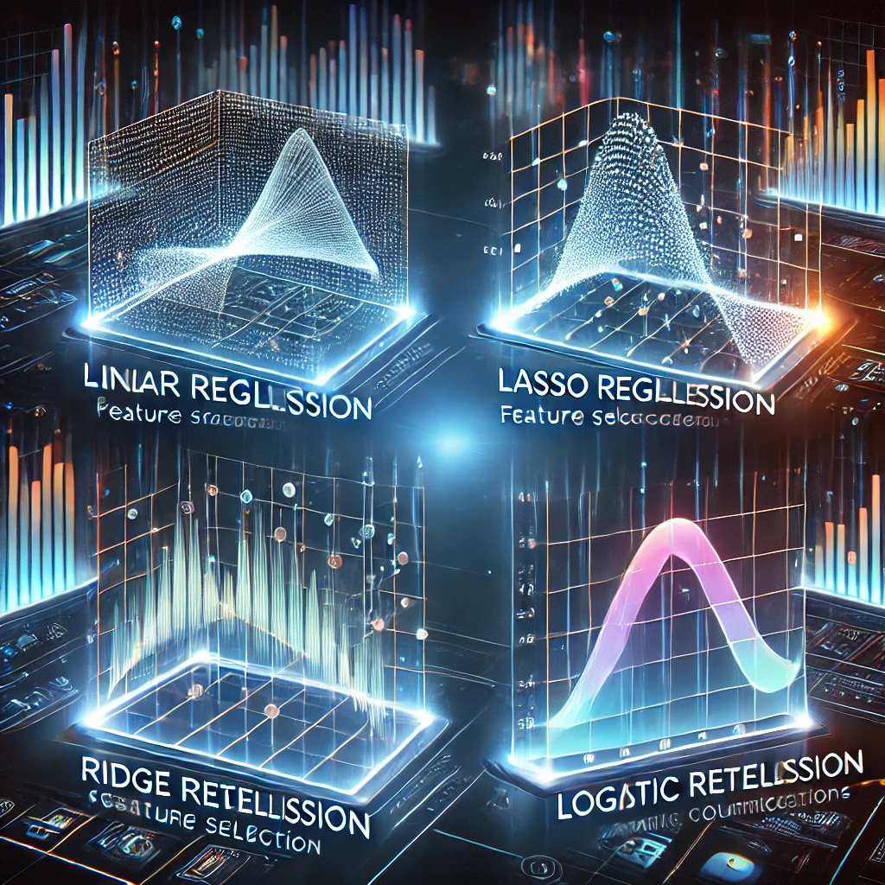
Preprocessing and Data Preparation for Regression Models
Handling Missing Values
Encoding Categorical Variables
Feature Selection
Train-Test Split
Standardization
Metrics Used:
Accuracy: Measures the proportion of correctly classified cases.
RMSE (Root Mean Squared Error): Evaluates prediction error

Slide 20
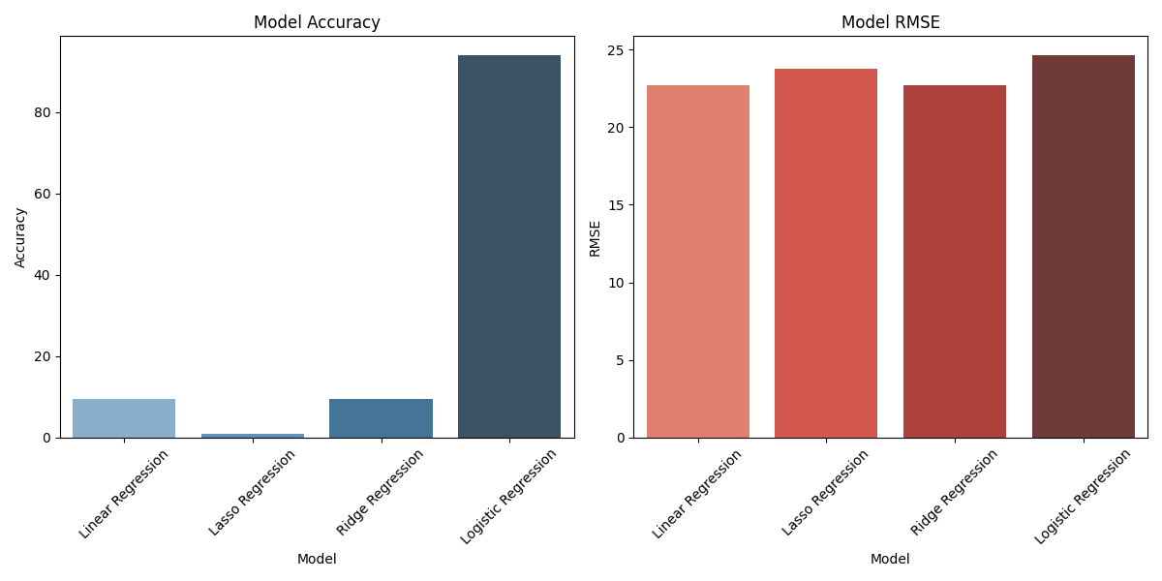
Model Performance Summary: RMSE and Accuracy
Model | Accuracy | RSME
Linear Regression | 9.10% | 22.76%
Lasso Regression | 0.94% | 23.76%
Ridge Regression | 9.10% | 22.76%
Logistic Regression | 93.93% | 24.63%

Slide 21

Observation
Accuracy Observation: Logistic Regression achieves the highest accuracy at 93.93%, significantly outperforming Linear, Lasso, and Ridge Regression models, which have accuracies below 10%. This suggests that logistic regression is the most appropriate model for binary classification tasks like stroke prediction
RMSE Observation: Linear, Lasso, and Ridge Regression models show similar RMSE values (~0.23), indicating consistent performance in predicting continuous values. Logistic Regression, with a slightly higher RMSE of 0.246, is less relevant in this context since it is designed for classification, not continuous value prediction

Slide 22

Precision, Recall, F1 Score, and Accuracy
Precision (P): Measures how many predicted "Stroke" cases are correct. P= TP/[TP+FP]
Recall (R): Measures how many actual "Stroke" cases are correctly identified. R=TP/[TP+FN]
F1 Score: Harmonic mean of Precision and Recall, providing a balance between both. F1 Score= 2*(P x R/P+R)
Accuracy: Overall correctness of the predictions. Accuracy=(TP+TN)/(TP+TN+FP+FN)

Slide 23
Precision: 0.50 Precision is the ratio of correctly predicted positive observations to the total predicted positives. A precision of 0.50 means that 50% of all the cases predicted as stroke actually have a stroke. This is decent, but it could be better.
Recall: 0.02 Recall is the ratio of correctly predicted positive observations to the all observations in actual class. A recall of 0.02 means that only 2% of the actual stroke cases are correctly identified by the model. This indicates a poor performance in identifying stroke cases, which is critical for this prediction task.
F1 Score: 0.03 F1 Score is the weighted average of Precision and Recall. With a value of 0.03, the model struggles to balance precision and recall, meaning it fails to both correctly predict stroke cases (low recall) and predict strokes with certainty (moderate precision).
Accuracy: 93.93% The accuracy score is quite high, but it can be misleading in imbalanced datasets. High accuracy can occur if the model correctly predicts the majority class (no stroke) but fails to identify the minority class (stroke). Given that the dataset is likely imbalanced, this accuracy should be interpreted carefully.
Precision, Recall, F1 Score, and Accuracy Score

Slide 24
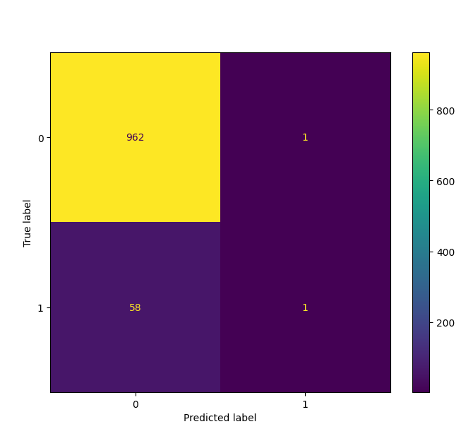
The confusion matrix for the logistic regression model
This matrix shows a significant imbalance between the true negatives and false positives/negatives, indicating that the model is overwhelmingly predicting no stroke, which may be a result of class imbalance in the dataset

Slide 25
Model Performance
Where the Model Performs Well:
True Negatives (TN): The model performs very well in identifying non-stroke cases, with 962 correct predictions of no stroke.
Accuracy: Despite the poor recall, the accuracy is quite high (93.93%) because the model heavily favors predicting the majority class (no stroke).
Where the Model Lacks:
Recall: The low recall (0.02) suggests that the model is almost completely missing the stroke cases. This is a critical issue because failing to identify stroke cases could have severe consequences.
F1 Score: The low F1 score (0.03) reinforces the imbalance between precision and recall, meaning the model's ability to correctly predict both stroke and non-stroke is poor.
False Negatives (FN): A high number of false negatives (58) means the model is misclassifying a large number of stroke cases as non-stroke.

Slide 26
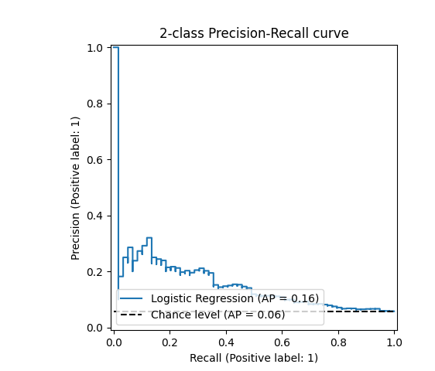
Precision Recall curve
The Precision-Recall curve evaluates the logistic regression model's ability to classify stroke cases (positive label = 1).
Key Insights:
The area under the curve (AP = 0.16) shows limited predictive power but performs better than random guessing (AP = 0.06).
Higher recall values are associated with lower precision, indicating many false positives
Conclusion: The model needs improvement, as precision remains low for most recall values

Slide 27
Observation
Logistic Regression works well in predicting the majority class (non-stroke), but fails to detect stroke cases effectively.
Accuracy is high (93.93%) but not indicative of good model performance due to the class imbalance.
Precision is acceptable, but Recall and F1 Score are poor, indicating a significant issue in detecting the minority class (stroke).

Slide 28

Is accuracy a factor for model performance?
Accuracy is misleading in imbalanced datasets, where one class dominates the other. In this case, the dataset is highly imbalanced with 95% of the instances belonging to the negative class (no stroke) and only 5% to the positive class (stroke). A model can achieve high accuracy by simply predicting the majority class (no stroke), even if it fails to predict the minority class (stroke), which is often the class of interest. This results in poor performance for the minority class, making accuracy an unreliable metric. Instead, metrics like precision, recall, and F1 score are more informative for assessing model performance in imbalanced scenarios

Slide 29

Dataset Bias ?
Is the Dataset Biased?
Yes, the dataset appears to be imbalanced, as the model performs poorly at identifying stroke cases (with a recall of only 0.02). This suggests that the number of stroke cases (minority class) is much lower than non-stroke cases (majority class).
Class Imbalance: The model is heavily biased towards the majority class (non-stroke), which is why it has high accuracy but low recall for stroke detection. It tends to predict "no stroke" more often because there are far more non-stroke cases in the dataset

Slide 30

Impact on Performance: High accuracy, but poor detection of minority class (stroke).
Evaluation Metrics: Accuracy misleading; precision, recall, and F1 score provide better performance insights.
Class Imbalance: 95% negative, 5% positive class.
Analysis: Logistic Regression outperformed others, but struggled with stroke detection due to imbalance
Model Performance Analysis in Imbalanced Datasets

Slide 31
Address Class Imbalance: Use SMOTE or undersampling to balance the dataset.
Use Alternative Metrics: Focus on Precision, Recall, and F1-Score.
Model Improvement: Explore models like Gradient Boosting or Logistic Regression with Class Weights.
Further Data Exploration: Investigate additional features for better predictions
Recommendations

Slide 32
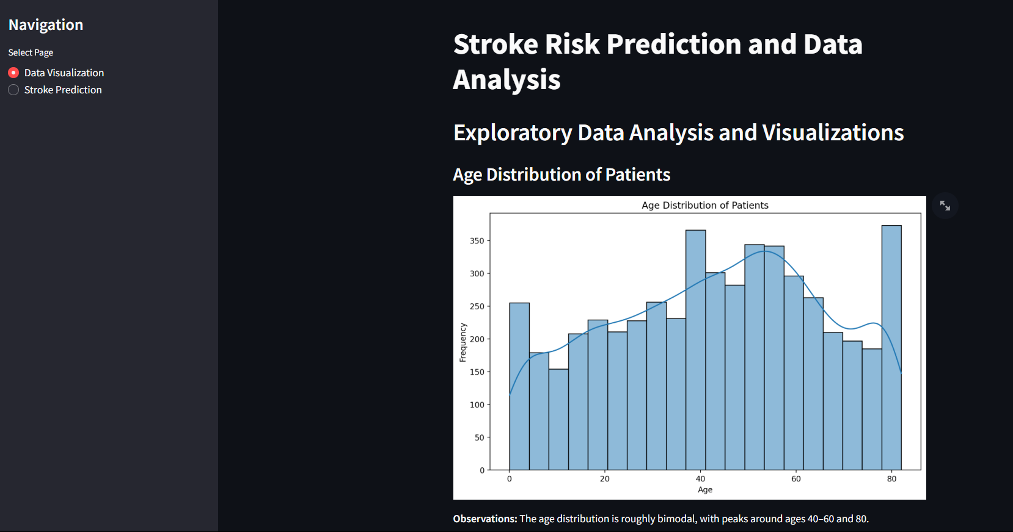
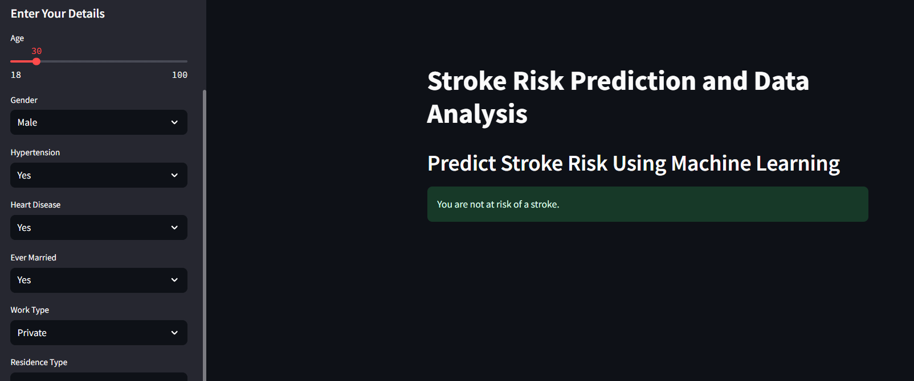
Streamlit WebApplication

Slide 33
Thank You

